Slide 1
Chapter03 IP Addressing
Session 01
Introduction to
IP Address

Slide 2

OBJECTIVES FOR TODAY
Understanding the IP protocol work
Be able to identify formatting of IP addresses
Understanding the DHCP server work
Be able to show IP address on computer by CMD command

Slide 3



ENGAGE
Look at these IPv4 Addresses
5 MIN
192.168.0.1
100.95.5.169
165.1.200.10
172.16.30.100
10.10.250.1
192.168.100.200
10.200.55.30
Find out the common things among these IP Addresses
Notes:
Answer:
All have 4 octets
All number start from 0 – 200
All number are positive number

Slide 4
Introduction to IP Address

Slide 5


What is Internet Protocol (IP)?
EXPLAIN
10 MIN
How do message find the destination once they leave the source?
The internet is composed of a huge number of computers that send packets of data to each other. They use IP addresses to know exactly where to send the data.
Notes:
Message carry with them an address that is unique to the device for which the message is intended. IP address is used by routers to find the way to route to the destination.
This address format is defined by Internet Protocol (IP) and is called IP address.

Slide 6

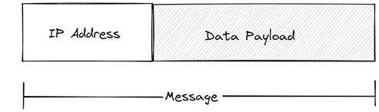
What is Internet Protocol (IP)?
EXPLAIN
10 MIN
IP Address is a unique address that identifies a device (computer) on the internet or a local network. IP stands for “Internet Protocol”.
IP address is used by routers to find the source and destination addresses that then determine how packets are transmitted and routed.
Notes:
Message carry with them an address that is unique to the device for which the message is intended. IP address is used by routers to find the way to route to the destination.
This address format is defined by Internet Protocol (IP) and is called IP address.

Slide 7
ENGAGE
5 MIN
How IP address important to network communication ?
Notes:
Answer:
All have 4 octets
All number start from 0 – 200
All number are positive number

Slide 8
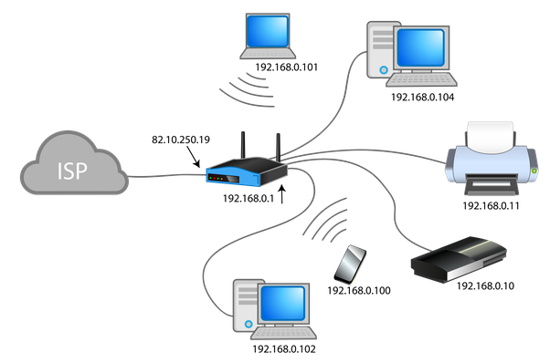
Network and IP addresses

Slide 9
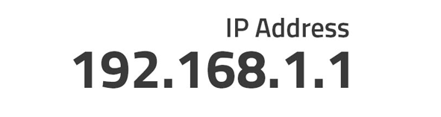

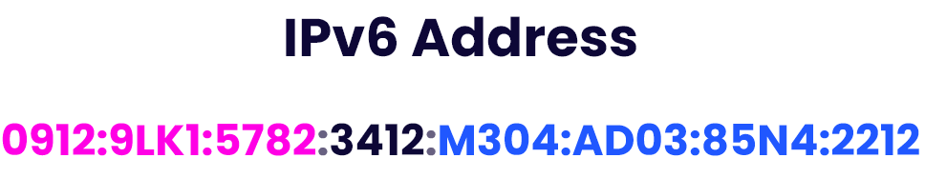
IP Address Version
EXPLAIN
10 MIN
Versions of IP addresses
IPv4 addresses
Can support around 4.3 billion devices to connect
Most commonly used today
IPv6 addresses
Can support more than 340 undecillion devices to connect
Not widely used
Notes:
Client-server network:
Centralize management
Better protected on a single server
Adding new feature without interrupt
Backup and recover more easily

Slide 10
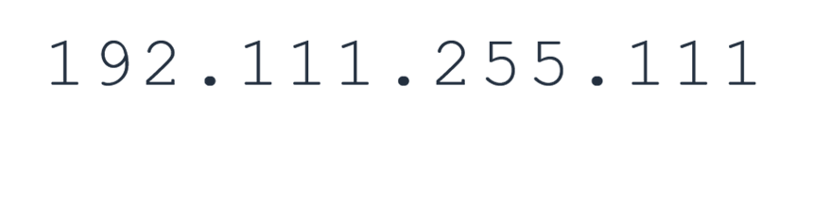
IPv4 Address Formatting
EXPLAIN
10 MIN
Parts of the IPv4 address :
For IPv4 addresses, they are divided into parts called octets.
Bits
An IPv4 address is written in decimal digits, formatted as four fields from 0 to 255.
Dots
Each octet is separated with a dot.
Notes:
Client-server network:
Centralize management
Better protected on a single server
Adding new feature without interrupt
Backup and recover more easily

Slide 11
IPv4 Address Classes
EXPLAIN
10 MIN
IPv4 address are divided into 5 classes named A, B, C, D, and E.
Each class characterize a range of IP addresses.
Class | Range (Full Address)
A | 0.0.0.0 –126.255.255.255
B | 128.0.0.0 –191.255.255.255
C | 192.0.0.0 –223.255.255.255
D | 224.0.0.0 –239.255.255.255
E | 240.0.0.0 –255.255.255.255
Notes:
Client-server network:
Centralize management
Better protected on a single server
Adding new feature without interrupt
Backup and recover more easily

Slide 12
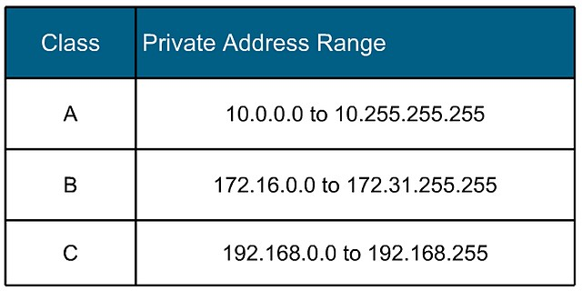
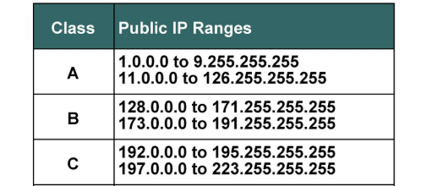
Private vs Public IP Addresses
EXPLAIN
10 MIN
An IP address is basically classified into two types:
Private IP address : used to communicate within the same network (local).
Public IP address : used to communicate outside the network (internet) and assigned by ISP.
Notes:
Peer-to-peer network:
File sharing become easy.
Not require expert
New client added easily

Slide 13
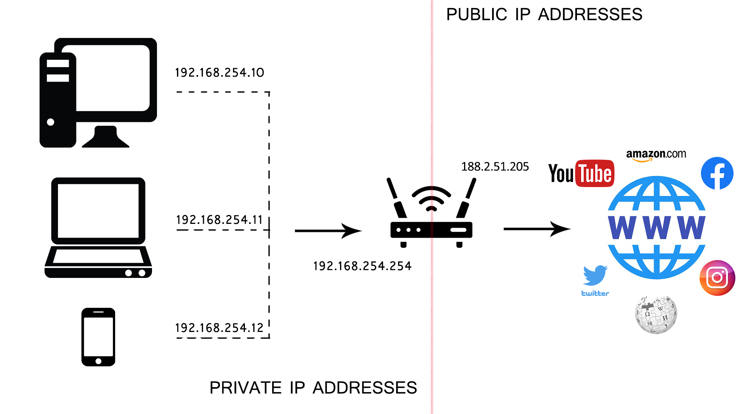
Private vs Public IP Addresses
EXPLAIN
10 MIN
Notes:
Peer-to-peer network:
File sharing become easy.
Not require expert
New client added easily

Slide 14

ENGAGE
Let’s find out which class and type of IPv4 address !
5 MIN
172.16.30.100
192.168.250.10
10.200.30.35
1.140.0.5
172.16.1.1
195.2.10.7
Notes:
Answer:
All have 4 octets
All number start from 0 – 200
All number are positive number

Slide 15
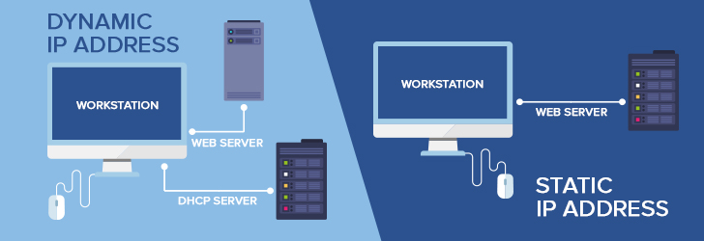
Static vs Dynamic IP Addresses
EXPLAIN
10 MIN
How you assign IP to your computer?
Notes:
Peer-to-peer network:
File sharing become easy.
Not require expert
New client added easily

Slide 16
DHCP Server

Slide 17

EXPLORE
5 MIN
Who assign IP address to computer?
How to get IP address?
How to know what is my IP address?

Slide 18
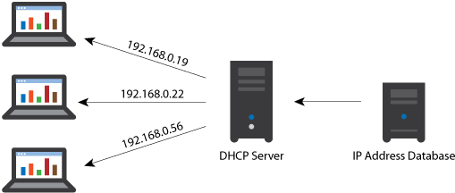
EXPLAIN
DHCP Server
5 MIN
DHCP Server is a server that automatically provides and assign IP addresses and other network information to client devices in the network.

Slide 19
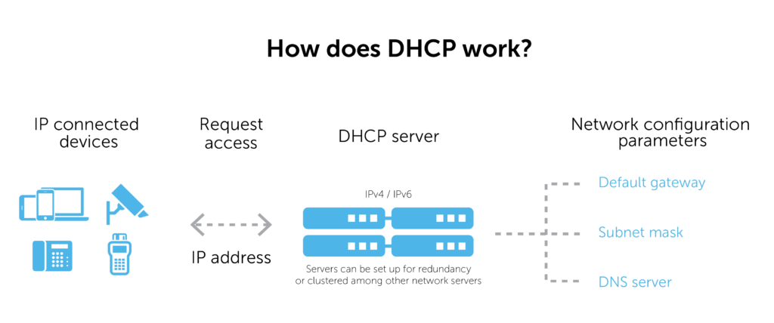
EXPLAIN
5 MIN

Slide 20
ENGAGE
5 MIN
What protocol and port that DHCP Server use?
Notes:
Answer:
All have 4 octets
All number start from 0 – 200
All number are positive number

Slide 21

ENGAGE
5 MIN
Let simulate how DHCP server work
Notes:
Answer:
All have 4 octets
All number start from 0 – 200
All number are positive number

Slide 22
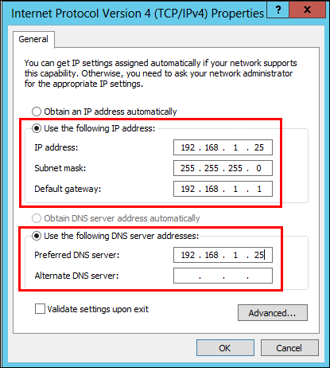
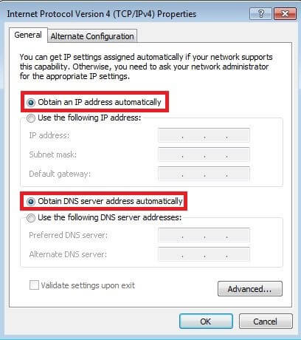
EXPLAIN
How to get IP address from DHCP Server
5 MIN
Static IP
Dynamic IP

Slide 23
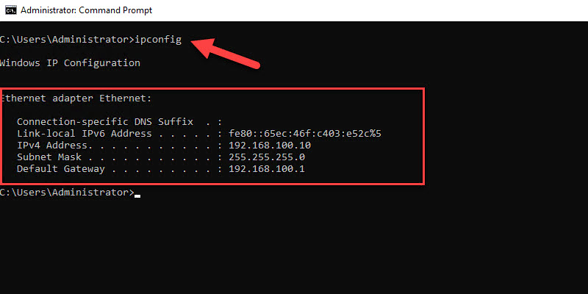
EXPLAIN
How to show IP address?
5 MIN

Slide 24
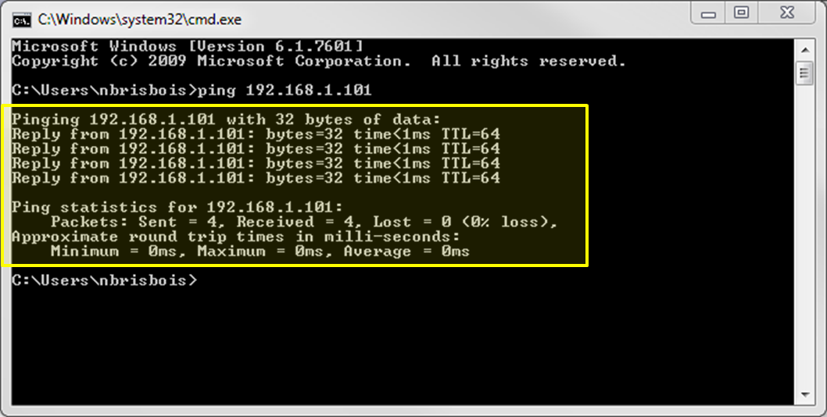
EXPLAIN
Ping Command
5 MIN

Slide 25

ENGAGE
5 MIN
Tell me what is your IP Address on your computer ?
Notes:
Answer:
All have 4 octets
All number start from 0 – 200
All number are positive number

Slide 26


